Slide 1
ADVERBS
ENGLISH LEVEL 5
DOCENTE:
MARIA DOLORES
ALUMNOS:
Martin Macedo
Alejandra Barajas González
Diego
Thursday March 3rd 2011, Puerto Vallarta Jalisco

Slide 2
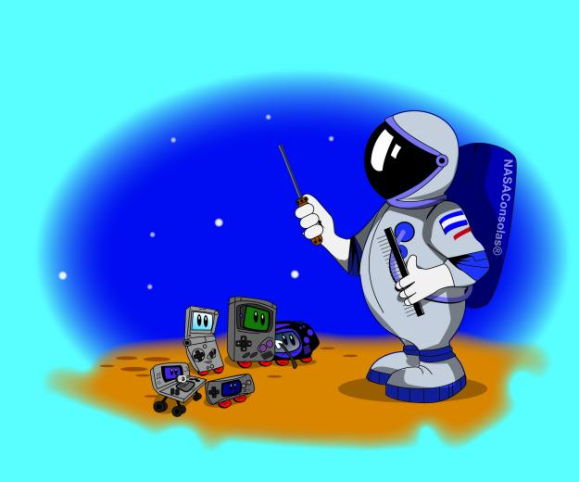
What is an Adverb?
Adverbs are words that modify
verbs
He drove slowly. — How did he drive?
Adjectives
He drove a very fast car. — How fast was his car?
other adverbs
She moved quite slowly down the aisle. — How slowly did she move?

Slide 3
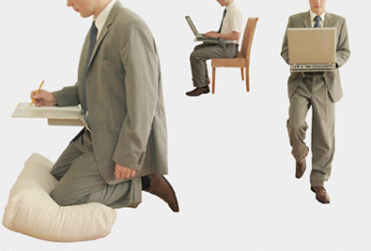
An adverb indicates:
Manner
Time
Place
Cause, under what conditions something happens or happened
Degree

Slide 4
Adverbs answer questions like:
HOW?
WHEN?
WHERE?
HOW MUCH?

Slide 5
Form:
Adjective | Adverb
dangerous | dangerously
careful | carefully
nice | nicely
easy | easily
horrible | horribly
electronic | electronically
Irregular forms
good | well
fast | fast
hard | hard
Adjective + ly
Note: Not all words ending in -ly are adverbs.
Adjectives ending in -ly: friendly, silly, lonely, ugly Nouns, ending in -ly: ally, bully, Italy, melancholy Verbs, ending in -ly: apply, rely, supply
There is no adverb for an andjective ending in -ly.

Slide 6
Spelling rules -
By the form of an adverb we must have put -ly at the end of an adjective. But we have to chek the next:
We put-ly at the adjectives ending with a vocal+l and at the adjectives ending with a consonant+e.
careful ==> carefully
polite ==> politely
We have to add-y at the adjectives ending on -ll.
full ==> fully
The adjectives ending with a consonant +le losts the -e and get -y.
comfortable ==> comfortably
terrible ==> terribly

Slide 7
The adjectives ending on -y, changes the -y for -i before to add -ly.
happy ==> happily
noisy ==> noisily
The adjectives ending on -ic change for -ally.
tragic ==> tragically
And there is some exceptions to the rules by irregular adjectives like good
good ==> well

Slide 8
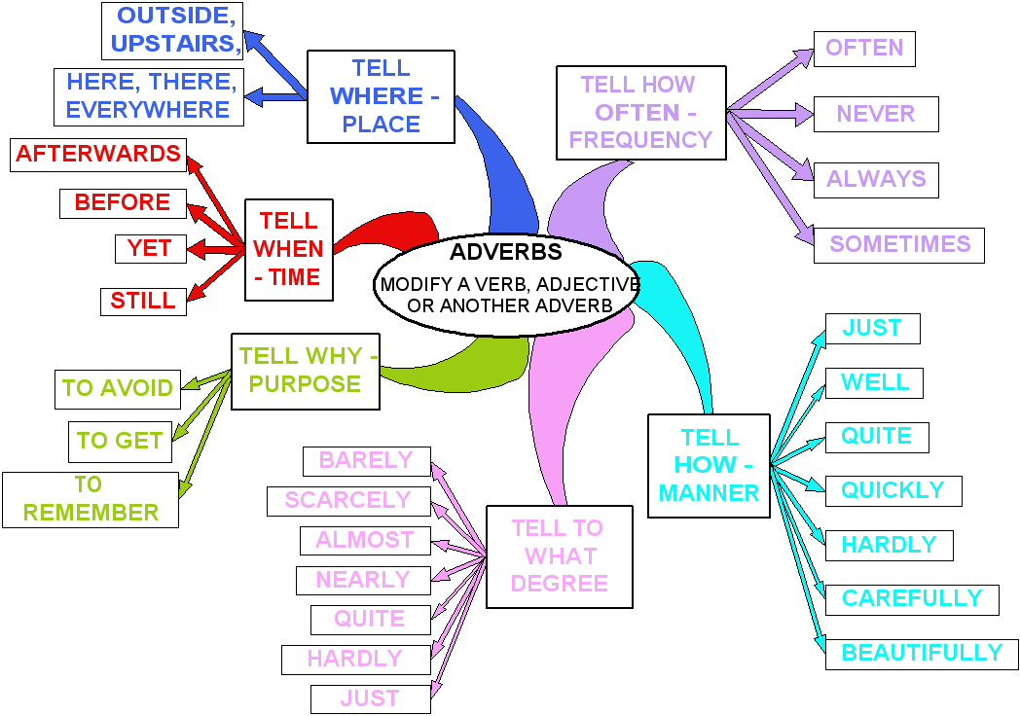

Slide 9
Adverbs of maner
An adverb of manner modifies a verb and tells us something about the way an action happens or is happening, for example:
She sings beautifully.
He runs quickly.
Elephants move slowly.

Slide 10
Adverbs of frecuency
Always
Usually
Regularly
Normally
Often
Sometimes
Occasionally
Rarely
Seldom
Never
The position of these adverbs is:
before the main verb

Slide 11
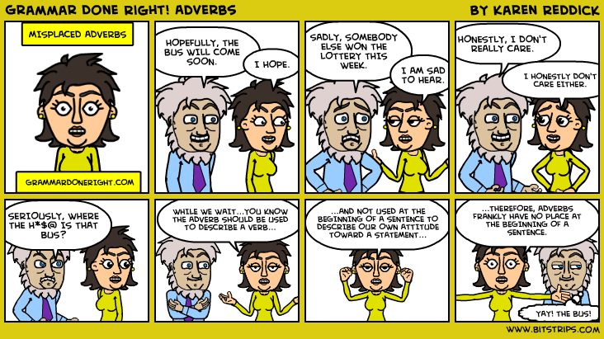

Slide 12
http://www.englisch-hilfen.de/en/grammar/adverbien1.htm
http://grammar.ccc.commnet.edu/grammar/adverbs.htm
http://usuarios.multimania.es/theenglishcorner/Grammar/adverbs_of_frequency_and_manner.htm#Adverbs of manner - Los adverbios de modo

