Slide 1
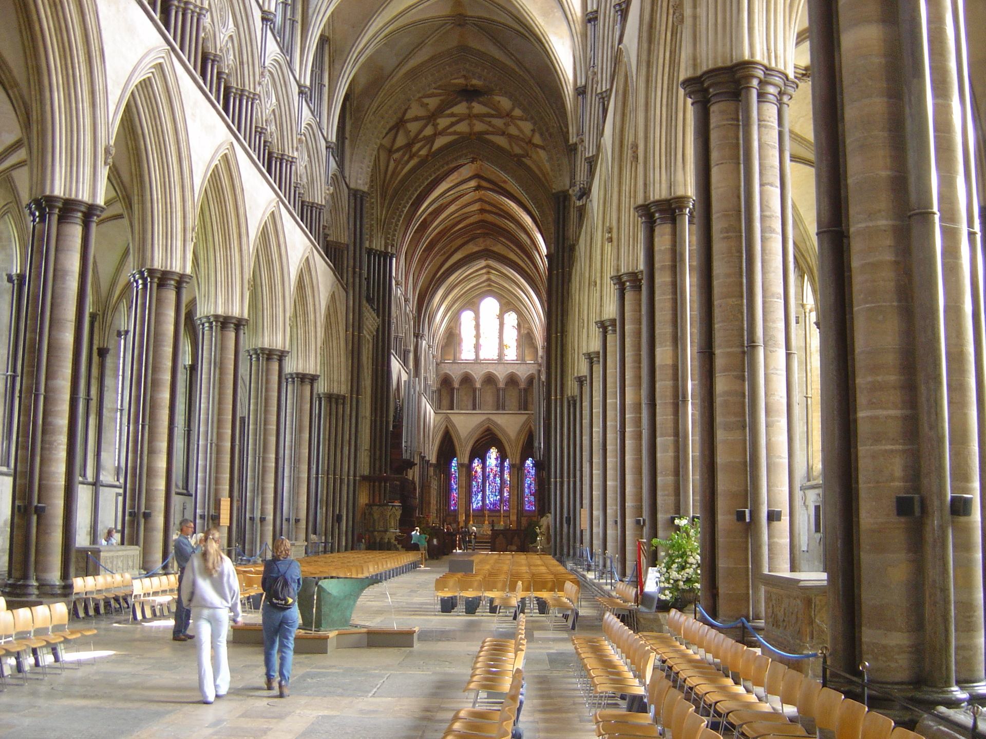
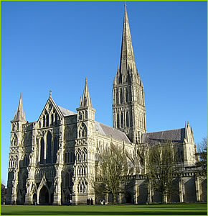
On September 20th, 1258

Slide 2
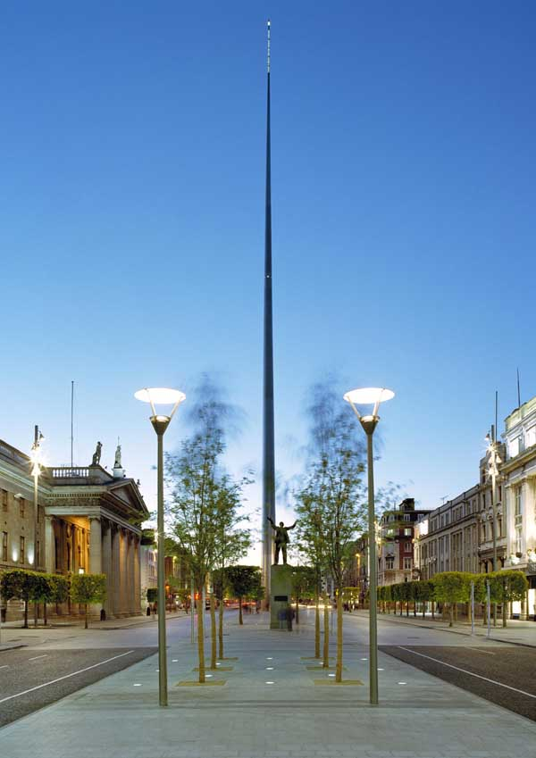
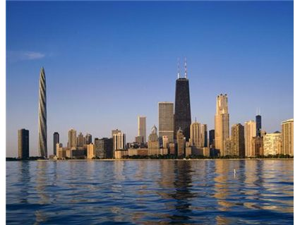
The awesome sight of Salisbury Cathedral spire never fails to impress.

Slide 3
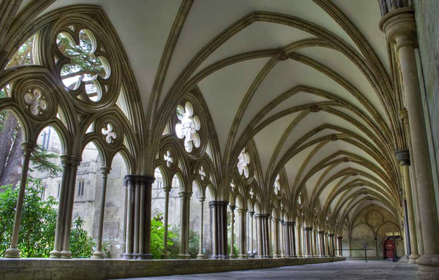
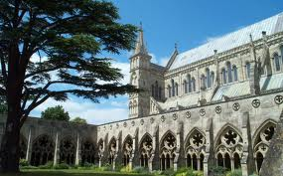
The Salisbury Cathedral, England, one of the most important examples of gothic architecture, was consecrated. The construction of the cathedral started in 1220 under the guidance of architect Elias de Derham, but it was not finished until 1315 when the slender soaring spire was completed.
Solemnly dedicated /tall tower / column
Ascending / higher / going up /
Delicate, very narrow / slim /
style of architecture / Bishop’s Diocese

Slide 4
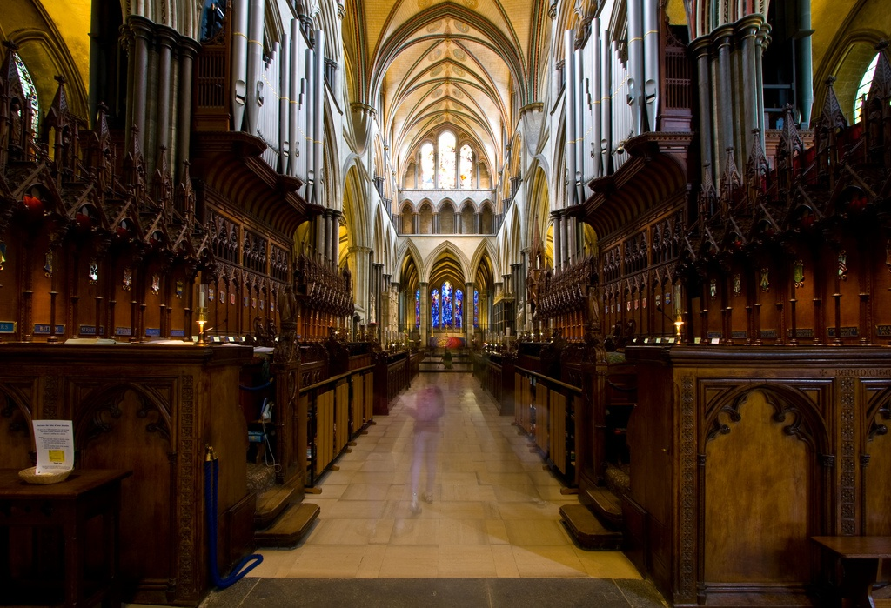
It is arguably (debate) the finest (elegant) example of the Early (beginning of the time) English Gothic (Goths) style of architecture (design and build) in Britain.

Slide 5
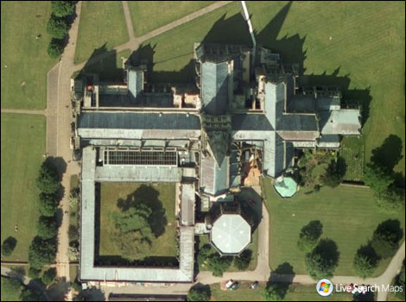

Slide 6
Bibliography
http://www.visitwiltshire.co.uk/salisbury/about-the-area/medieval-city/salisbury-cathedral
http://www.mail-archive.com/history@tlk-lists.com/msg00214.html
http://maps.google.com/maps?hl=en&tab=wl

