Slide 1
The Black Riders
Team
Axel David Zarate Jimenez
Fredy Oscar Escobar Alvarado
Richar Alfredo Salinas Santiago

Slide 2
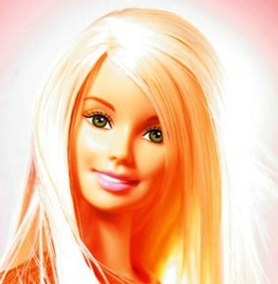
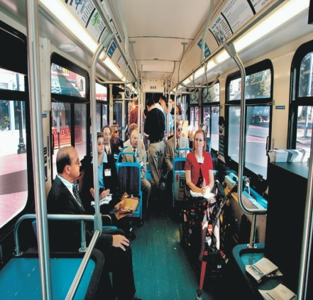
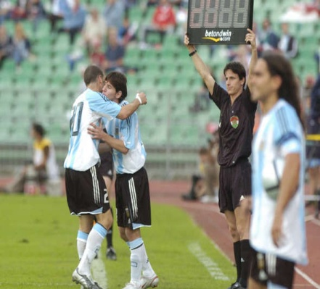
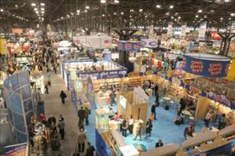
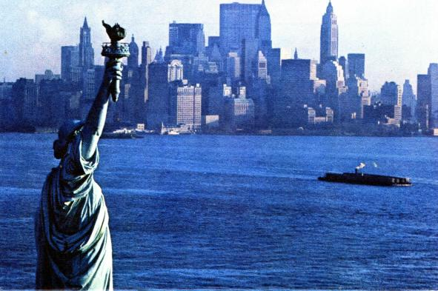
On March 9th, 1959
Barbie doll makes its public debut at the American International Toy Fair in New York.

Slide 3
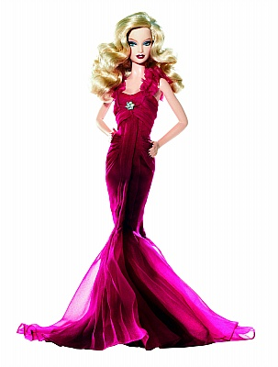
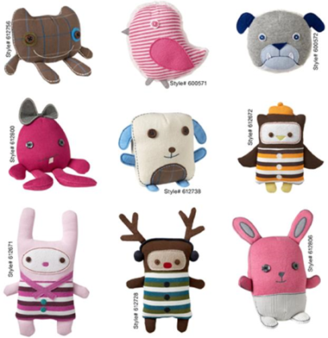
The American Barbie doll is one of the most successful toys.

Slide 4
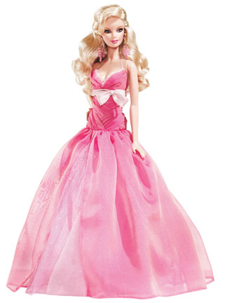
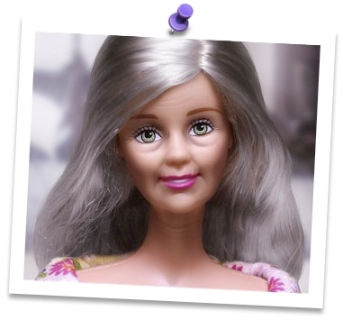
Barbie generates huge sales and a lot of controversy.

Slide 5
Bibliografy
http://www.history.com/this-day-in-history/barbie-makes-her-debut
http://photos.upi.com/slideshow/lbox/07f968f3b125d733840564b7f596edb3/Toy-Fair-in-New-York.jpg
http://blogpetitperovalent.blogspot.com/2010/06/spotify-list-american-life.html
http://www.famayfortuna.com/2009/04/barbie-la-rubia-mas-rica-y-famosa-en-el.html
http://www.marketingdirecto.com/actualidad/anunciantes/que-hacer-para-que-tu-marca-tenga-exito/
http://softhotel.mx/servicio/toys-r-us-black-friday-2010
http://geeknologia.com/wp-content/uploads/2011/01/juegos-barbie.jpg
http://proyectorweb.com/images/pr_increase_sales.jpg
http://learningfolder.net/images/controversy.jpg
http://blogofago.com/wp-content/imagenes/2007/11/old-barbie-2.jpg

