Slide 1
“Team Waver’s”
Luis Alfredo Cerrillo Hernández.
Jose Alejandro Cárdenas flores.
Christopher Zepeda Paniagua.

Slide 2
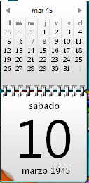
ephemeris of 1945
On March 10th, 1945

Slide 3
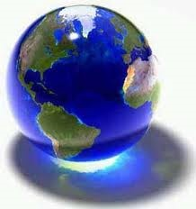
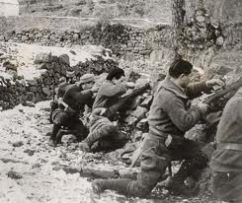
World War II

Slide 4
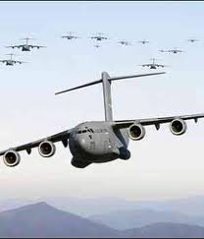
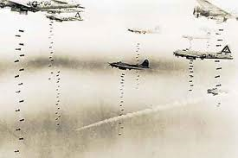
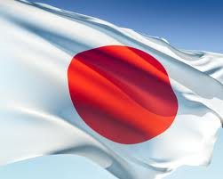
Three Hundred American Planes bomb Tokyo.

Slide 5
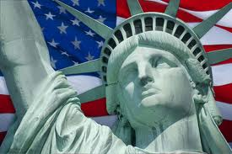
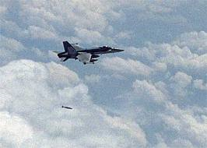
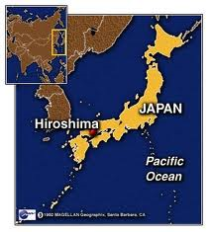
United States Drops Atomic Bombs on Hiroshima.

Slide 6
Links
http://puntocompuntoes.com.es/efemerides-10-de-marzo.php
http://www.google.com/images?um=1&hl=es&biw=1278&bih=820&tbs=isch%3A1&sa=1&q=bandera+japan&aq=f&aqi=g-s1&aql=&oq=
http://www.google.com/images?um=1&hl=es&tbs=isch:1&sa=X&ei=3zF5TYm-DJOssAOlkYWOAw&ved=0CDIQvwUoAQ&q=aviones+estadounidenses&spell=1&biw=1278&bih=820
http://www.google.com/images?um=1&hl=es&biw=1278&bih=820&tbs=isch%3A1&sa=1&q=bomb+atomica&aq=f&aqi=&aql=&oq=
http://www.google.com/images?um=1&hl=es&biw=1278&bih=820&tbs=isch%3A1&sa=1&q=planeta+tierra&aq=f&aqi=g10&aql=&oq=
http://www.google.com/images?um=1&hl=es&biw=1278&bih=820&tbs=isch%3A1&sa=1&q=300&aq=f&aqi=g10&aql=&oq=
http://www.google.com/images?um=1&hl=es&biw=1278&bih=820&tbs=isch%3A1&sa
http://www.google.com/images?um=1&hl=es&biw=1278&bih=820&tbs=isch%3A1&sa=1&q=war&aq=f&aqi=g10&aql=&oq==1&q=usa&aq=f&aqi=&aql=&oq=
http://www.google.com/images?um=1&hl=es&biw=1278&bih=820&tbs=isch%3A1&sa=1&q=dos&aq=f&aqi=&aql=&oq=
http://www.google.com/images?um=1&hl=es&biw=1278&bih=820&tbs=isch%3A1&sa=1&q=hiroshima&aq=f&aqi=g10&aql=&oq=

