Slide 1
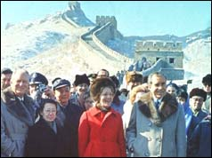
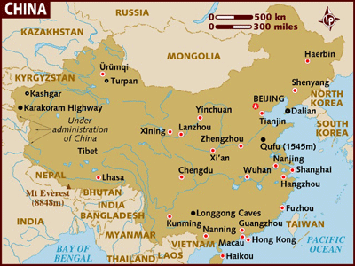
On
1972
Nixon makes historic visit to China
Figura 1
Figura 2
Figura 13
Figura 14

Slide 2
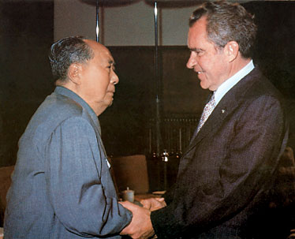
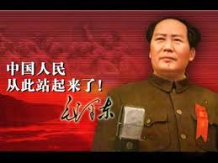
His visit begins with an audience with Chairman Mao Zedong at the leader's home.
Figura 3
Figura 4
Figura 5
Figura 6

Slide 3
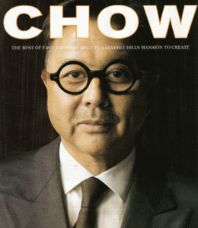
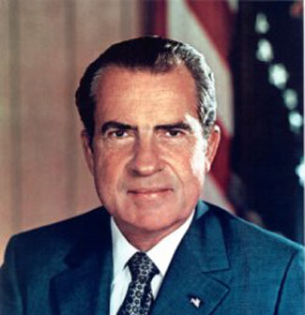
Mr. Chou describes the visit of President Nixon as a positive thing for China
Figura 7
Figura 11
Figura 12
Figura 8
Figura 9
Figura 10

Slide 4
Bibliografía
Figura 1:
http://news.bbc.co.uk/onthisday/hi/dates/stories/february/21/default.stm
Figura 2
http://www.gestur.com.do/dynamicdata/paquetes-internacionales.asp
Figura 3
http://pulserascollares.blogspot.com/
Figura 4
http://wefisi.blogspot.com/2009/04/inicio-de-campana.html
Figura 5
http://psicoblogging.wordpress.com/category/psicoblogging/l
Figura 6
http://history.cultural-china.com/en/46History9449.html
Figura 7:
http://brianlaesch.com/?p=147
Figura 8
http://enausenciadelaluz.blogspot.com/2010/07/nixon-y-el-watergate.html
Figura 9
http://picasaweb.google.com/lh/photo/eCxcIHETMTCprVao3VeqoA
Figura 10
http://www.gestiondelconocimiento.com/jornada2.htm

Slide 5
Figura 11:
http://hubpages.com/hub/WORDS-THAT-DESCRIBE-LOVE
Figura 12:
http://sfdiamondgirl.mlblogs.com/archives/2011/01/
Figura 13:
http://54-9.com.ar/tag/3g
Figura 14:
http://go.hrw.com/atlas/span_htm/china.htm

Slide 6
Team: Twilight
Members: Antonio Amaral
Erika Hernández
English Class
Thanks

